Slide 1

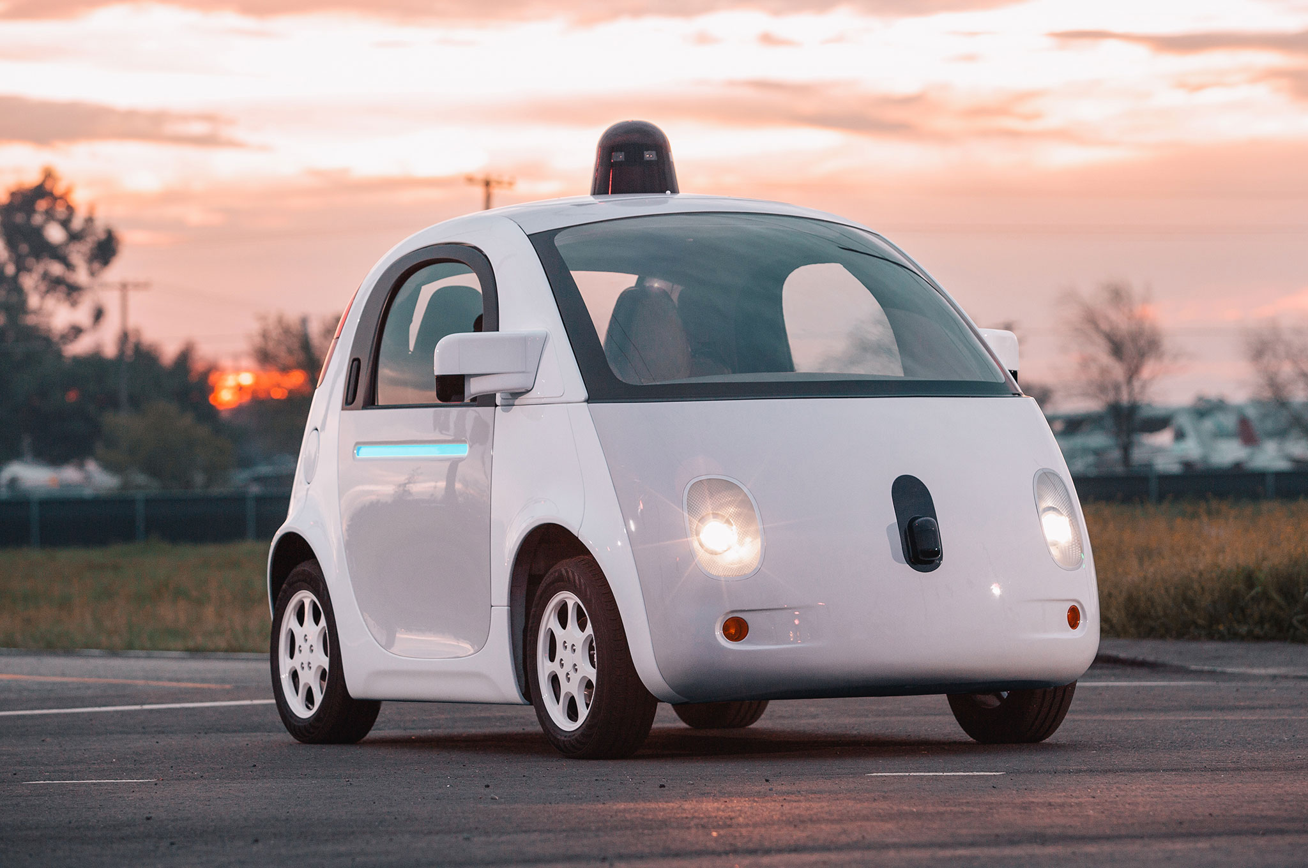
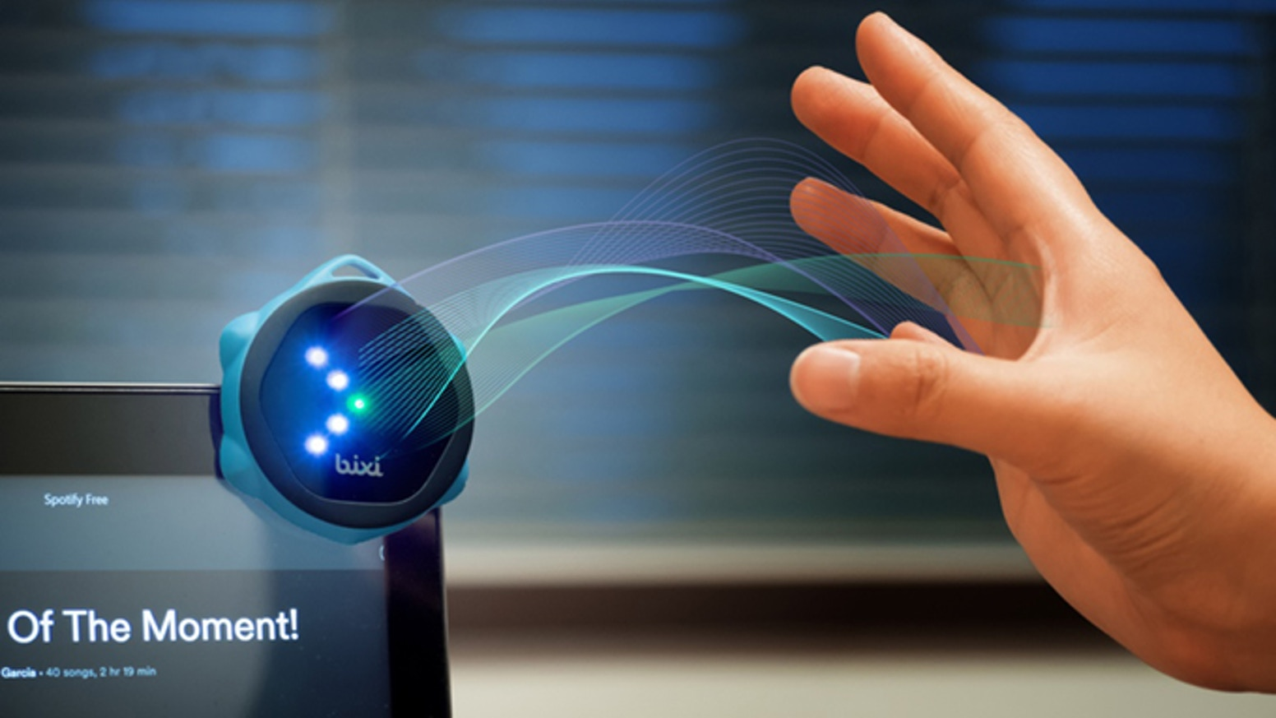
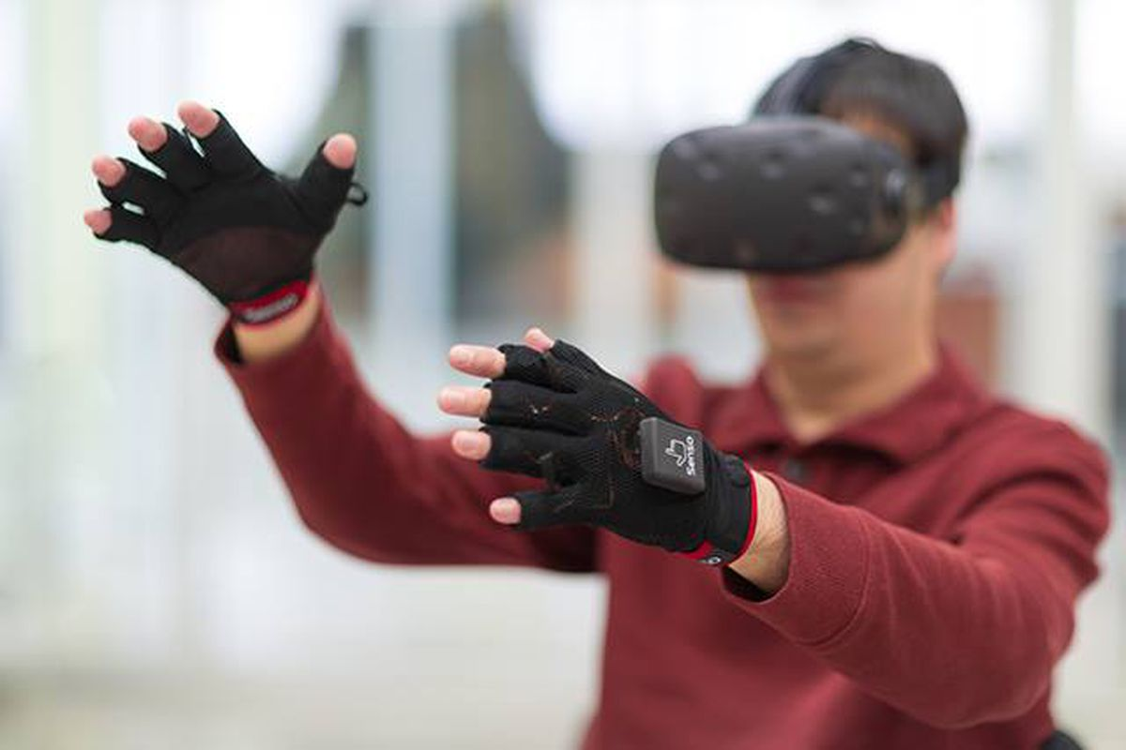

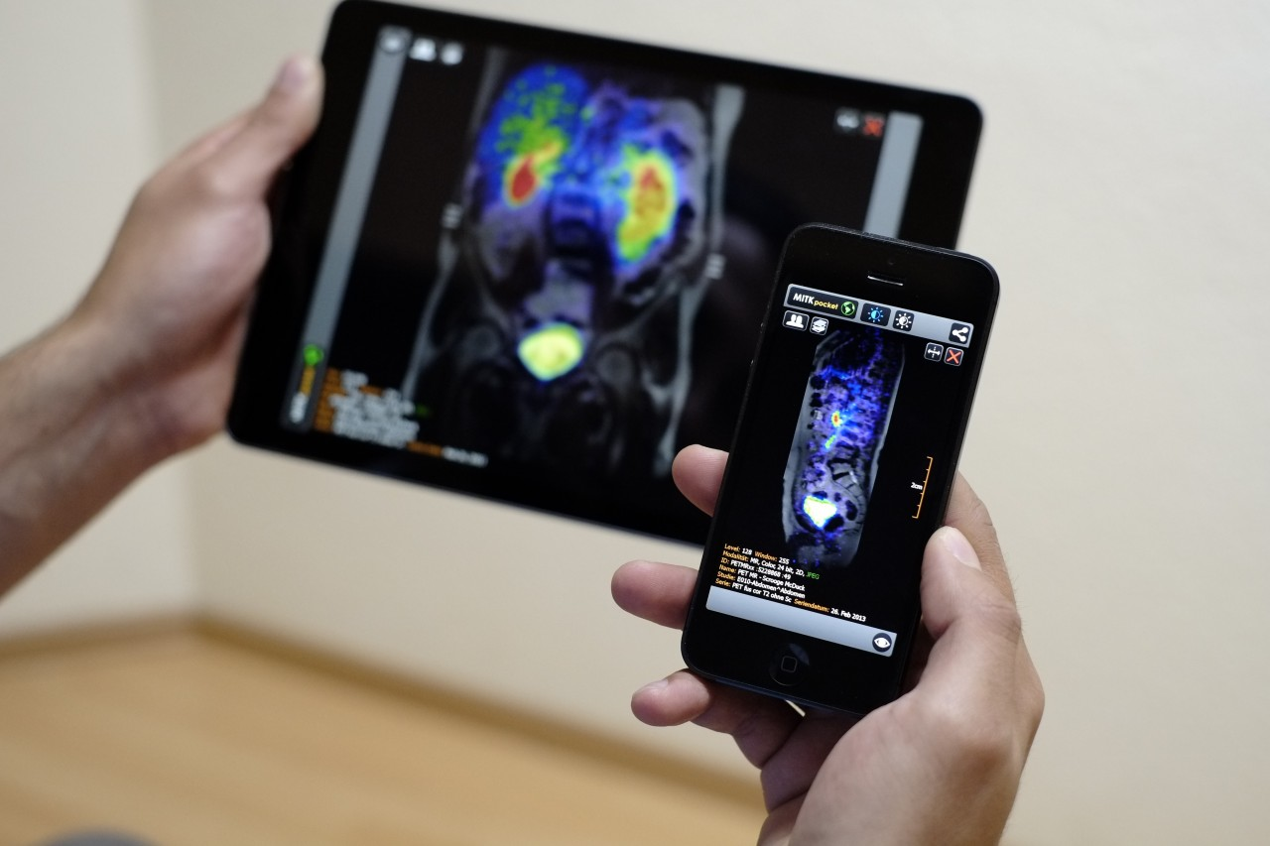
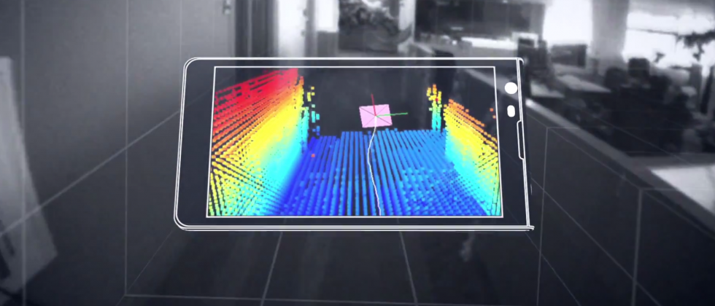
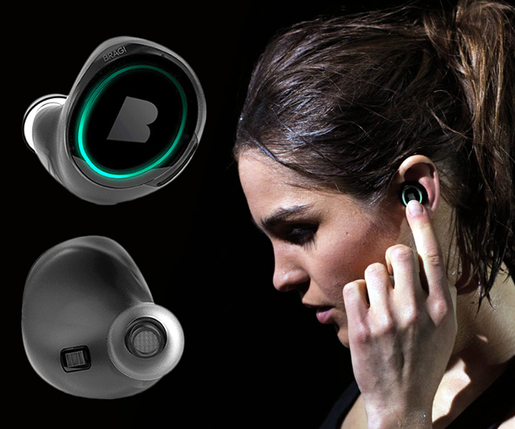
IoT and applications
Lecture 3.2: Machine Learning for IoT

Slide 2
Markov Model
Sunny
Sunny
Rainy
Sunny
Rainy
Rainy
t1 t2 t3 t4 t5 t6 (time)
P (sunny after rainy)
P (sunny after sunny)
P (rainy after rainy)
Sunny
day
Rainy
day
Temp.
P (rainy after sunny)
Temp.
Humidity
Humidity
Wind
Wind

Slide 3
Hidden Markov Model: Definition
Hidden states
S₁
S₁
S₂
S₃
S₄
S₁
S₂
M₁
M₁
M₂
M₃
M₄
Transition
Emission
Observations
1st order Markov assumption:
Transition probability depends on the current state only.
Output independence assumption:
Output/Emission probability depends on the current state only.

Slide 4
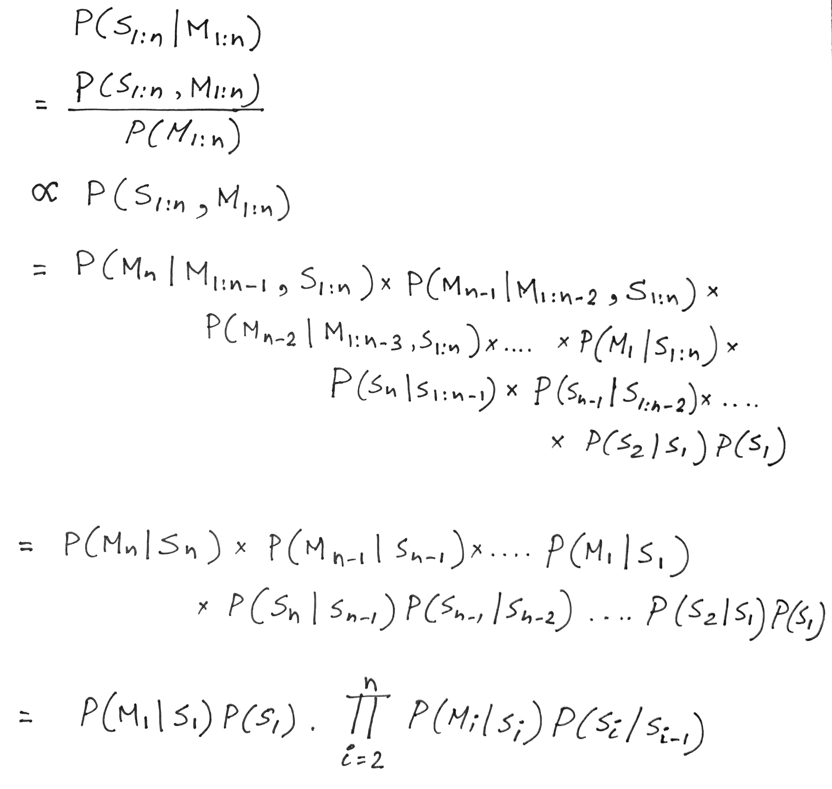
Hidden Markov Model: Definition
For N hidden states and a sequence of T observations, N^{T} different combinations

Slide 5
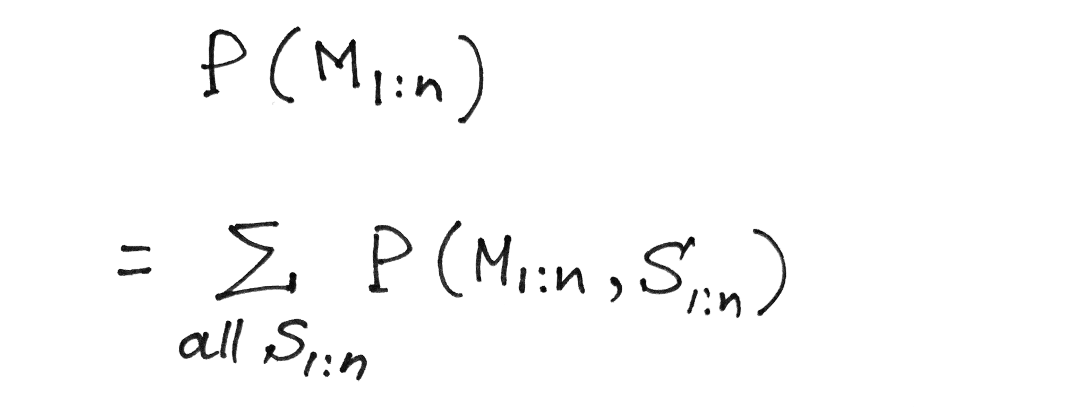
Hidden Markov Model: Definition
Probability of a given observation/measurement sequence
Marginal probability rule

Slide 6
Hidden Markov Model: Definition
Probability of a given observation/measurement sequence
Summation over all possible
combinations of hidden states

Slide 7
Hidden Markov Model: Definition
Probability of a given observation/measurement sequence
Summation over all possible
combinations of hidden states
For N hidden states and a sequence of T observations,
N^{T} different combinations

Slide 8
Hidden Markov Model: Definition
Forward-backward algorithm.
Viterbi algorithm

Slide 9
Problems solved by HMM
1) Likelihood:
Determine the likelihood of an observation sequence.
2) Decoding:
Given an observation sequence, determine the best sequence of hidden states.
[Viterbi algorithm]
[Forward-backward algorithm]
[Baum-Welch algorithm]
3) Learning:
Given an observation sequence and a sequence of states, learn the HMM parameters:
i) Transition probabilities
ii) Emission probabilities

Slide 10
Problems solved by HMM
1) Likelihood:
Determine the likelihood of an observation sequence.
2) Decoding:
Given an observation sequence, determine the best sequence of hidden states.
[Viterbi algorithm]
[Forward-backward algorithm]
[Baum-Welch algorithm]
3) Learning:
Given an observation sequence and a sequence of states, learn the HMM parameters:
i) Transition probabilities
ii) Emission probabilities

Slide 11
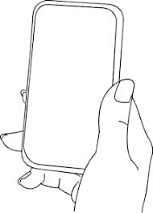
A simple gesture recognition example
States:
Observations:
No
Call
Call
Near
Far
Notes:
http://www.davidsbatista.net/assets/documents/posts/2017-11-11-hmm_viterbi_mini_example.pdf

Slide 12
A simple gesture recognition example
Start
End
St
No
Call
Call
Near
Far
Near
Far

Slide 13
A simple gesture recognition example
 | Call | NoCall | End
Start | 0.7 | 0.3 | 0
Call | 0.2 | 0.7 | 0.1
NoCall | 0.7 | 0.2 | 0.1
 | St | Near | Far
Start | 1 | 0 | 0
Call | 0 | 0.7 | 0.3
NoCall | 0 | 0.4 | 0.6
State transition
probabilities
Emission
probabilities

Slide 14
A simple gesture recognition example
Emission states are: Near, Far, Far
What is the hidden state sequence?

Slide 15
A simple gesture recognition example
i = 1 2 3
Call
Call
Call
Start
End
No
Call
No
Call
No
Call
St
Near
Far
Far

Slide 16
Hidden Markov Model: Definition

Slide 17
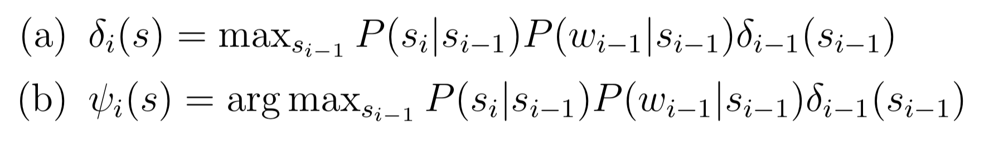
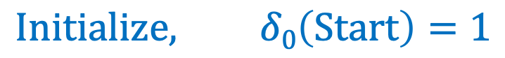
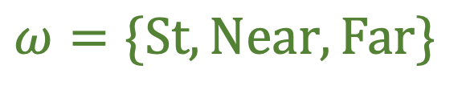
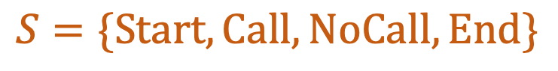
A simple gesture recognition example
Save two parameters per iteration, per state:
Recursion
$$Initialize, δ0\left(Start\right)=1$$
$$S=\{Start, Call, NoCall, End\}$$
$$ω=\{St, Near, Far\}$$
[Ref] http://www.davidsbatista.net/assets/documents/posts/2017-11-11-hmm_viterbi_mini_example.pdf

Slide 18
A simple gesture recognition example
i = 1 2 3
Call
Call
Call
Start
End
No
Call
No
Call
No
Call
St
Near
Far
Far

Slide 19
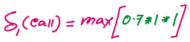
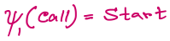
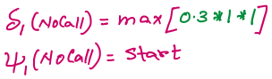
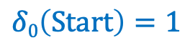
A simple gesture recognition example
i = 1
 | Call | NoCall | End
Start | 0.7 | 0.3 | 0
Call | 0.2 | 0.7 | 0.1
NoCall | 0.7 | 0.2 | 0.1
Call
State transition probabilities
Start
$$δ0\left(Start\right)=1$$
 | St | Near | Far
Start | 1 | 0 | 0
Call | 0 | 0.7 | 0.3
NoCall | 0 | 0.4 | 0.6
No
Call
St
Near
Emission probabilities

Slide 20
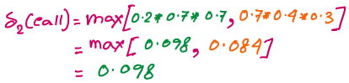
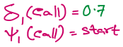
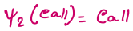
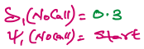
A simple gesture recognition example
i = 1 2
Call
Call
Start
No
Call
No
Call
Near
Far

Slide 21
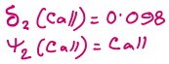
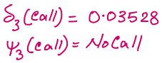
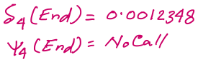
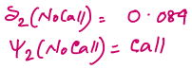
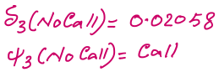
A simple gesture recognition example
i = 1 2 3
0.14406
Call
Call
Call
0.0043
Start
0.343
0.04116
End
No
Call
No
Call
No
Call
Near
Far
Far

Slide 22
A simple gesture recognition example
i = 1 2 3
Call
Call
Call
The values of delta and psi are not correct on this slide. Please refer to the calculation shown at the following link.
http://www.cs.umd.edu/class/fall2020/cmsc818w/course_materials/slides/Viterbi_solution.pdf
Start
End
No
Call
No
Call
No
Call
Near
Far
Far

Slide 23
A simple gesture recognition example
i = 1 2 3
0.14406
Call
Call
Call
0.0043
Start
0.343
0.04116
End
No
Call
No
Call
No
Call
Near
Far
Far

Slide 24
A simple gesture recognition example
i = 1 2 3
0.14406
Call
Call
Call
0.0043
Start
0.343
0.04116
End
No
Call
No
Call
No
Call
Near
Far
Far

Slide 25
A simple gesture recognition example
i = 1 2 3
0.14406
Call
Call
Call
For complete step by step solution of this example visit:
http://www.cs.umd.edu/class/fall2021/cmsc715/course_materials/slides/Viterbi_solution.pdf
0.0043
Start
0.343
0.04116
End
No
Call
No
Call
No
Call
Viterbi sequence: < Call, NoCall, Call >
P( <Call, NoCall, Call > | <Near, Far, Far>) = 0.0043
Near
Far
Far

